Slide 1
INTRODUCTION TO EPIGENOME-WIDE ASSOCIATION STUDIES (EWAS)
1. WELCOME AND INTRODUCTION TO THE COURSE

Slide 2
AIM
To introduce basic concepts and guidelines to conduct epigenome-wide association studies (EWAS) using DNA methylation data obtained from arrays.
Teachers:
Juan Ramon González (juanr.gonzalez@isglobal.org)
Mariona Bustamante (mariona.bustamante@isglobal.org)
Laura Balagué (laura.balague@isglobal.org)
Sofía Aguilar (sofia.aguilar@isglobal.org)
Felix P Chilunga

Slide 3
SESSIONS
Five sessions of 2 hours:
Day 1: Introduction to epigenetics and Bioconductor
Day 2: Pre-processing of DNA methylation data
Day 3: Epigenome-wide association studies (EWAS)
Day 4: Meta-analysis of epigenome-wide association studies (meta-EWAS)
Day 5: Biological interpretation
Each session:
Theory (30 min)
Practices
Introduction (all together – 15 min)
Practical session (in groups – 45 min)
Resolution (all together – 30 min)

Slide 4
MATERIAL
Material:
Laptop or computer with >8Gb RAM
Power points (XXXXXX)
Scripts (XXXXXXX)
Recommended papers:
Recommendations for the design and analysis of epigenome-wide association studies
https://clinicalepigeneticsjournal.biomedcentral.com/articles/10.1186/s13148-021-01200-8
Epigenetic Signatures of Cigarette Smoking
https://www.ahajournals.org/doi/full/10.1161/CIRCGENETICS.116.001506
Meffil: efficient normalization and analysis of very large DNA methylation datasets (ADDED NOW)
https://www.ncbi.nlm.nih.gov/pmc/articles/PMC6247925/

Slide 5
INTRODUCTION TO EPIGENOME-WIDE ASSOCIATION STUDIES (EWAS)
1. INTRODUCTION TO EPIGENETICS

Slide 6

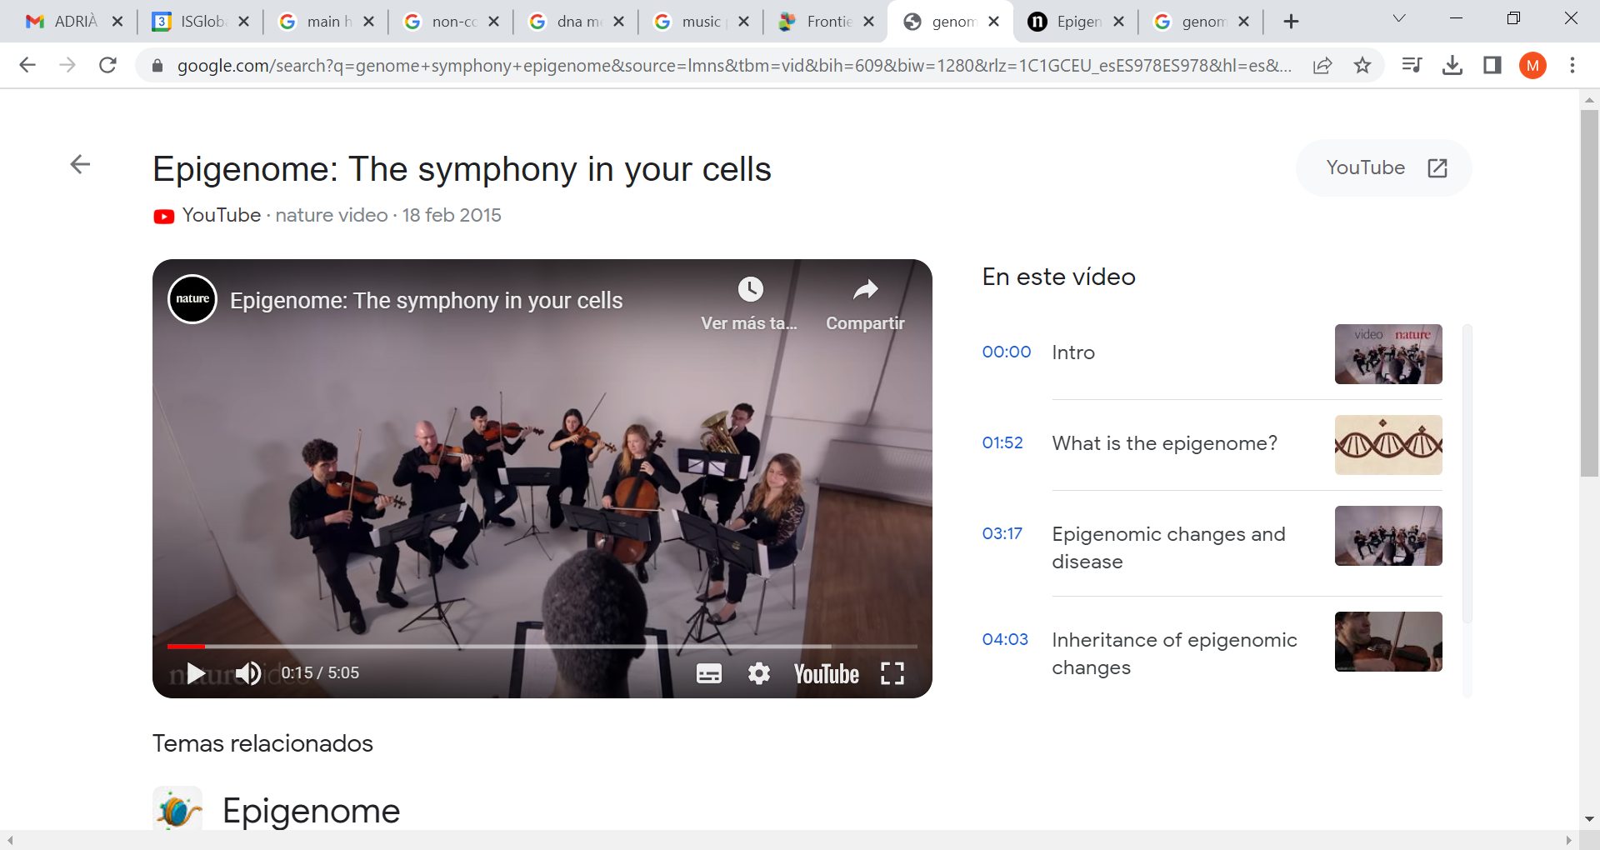
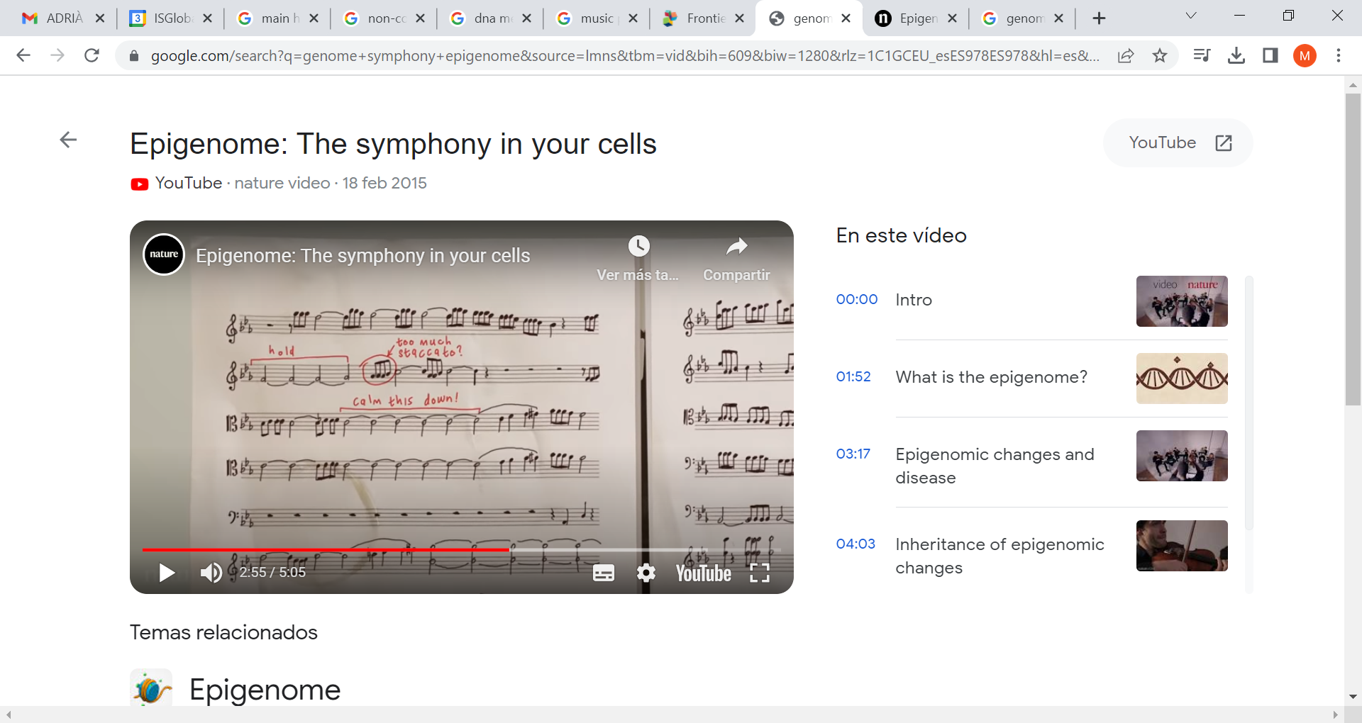
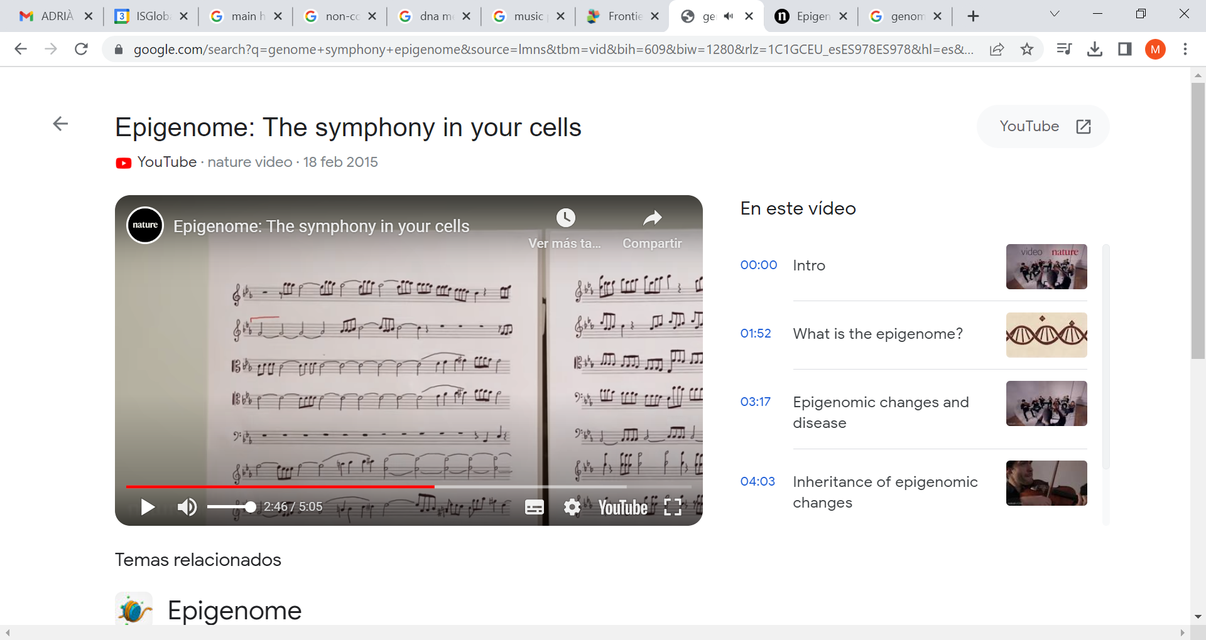
EPIGENOME
The sum of all modifications to DNA or to DNA-associated RNA and proteins, that permit interpretation of the genome to instruct cell identity and function.
https://www.google.com/search?q=genome+symphony+epigenome&source=lmns&tbm=vid&bih=609&biw=1280&rlz=1C1GCEU_esES978ES978&hl=es&sa=X&ved=2ahUKEwj20rC8msCAAxUypycCHaXLDGkQ0pQJKAJ6BAgBEAY#fpstate=ive&vld=cid:2d6174fc,vid:W3Kg9w-srFk
Symphony = Phenotype
Musicians = Epigenome
Partiture = Genome

Slide 7
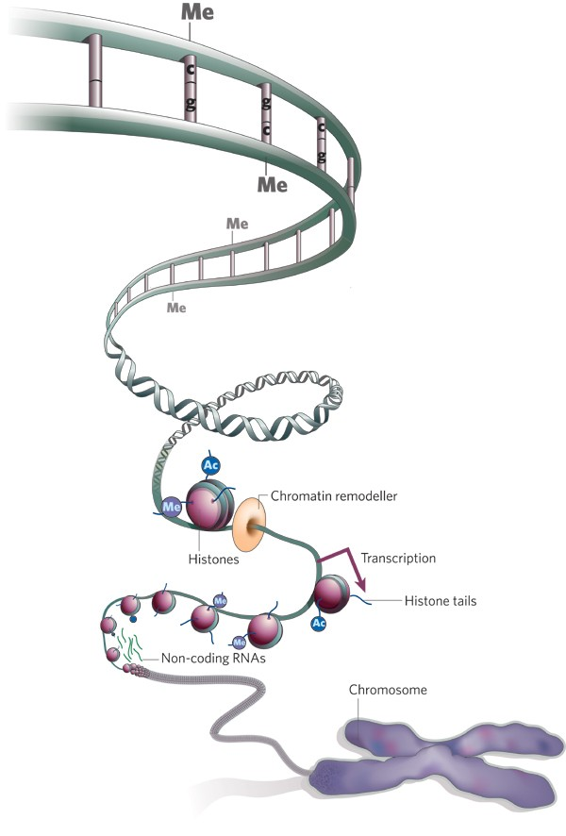
EPIGENETIC MARKS
DNA methylation
Histone modifications
Non-coding RNAs

Slide 8
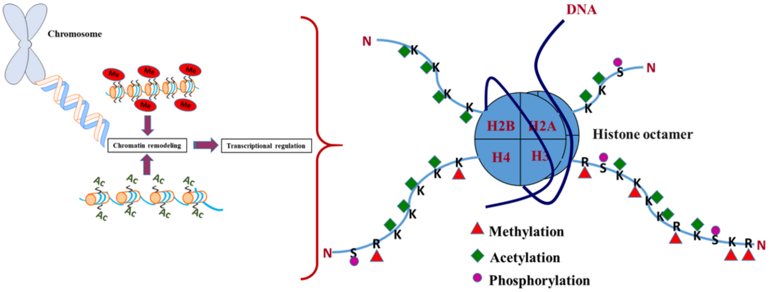
EPIGENETIC MARKS: HISTONE MODIFICATIONS
Histone modifications
Histones: proteins needed for DNA packaging
Kumar et al. Int. J. Mol. Sci. 2020

Slide 9
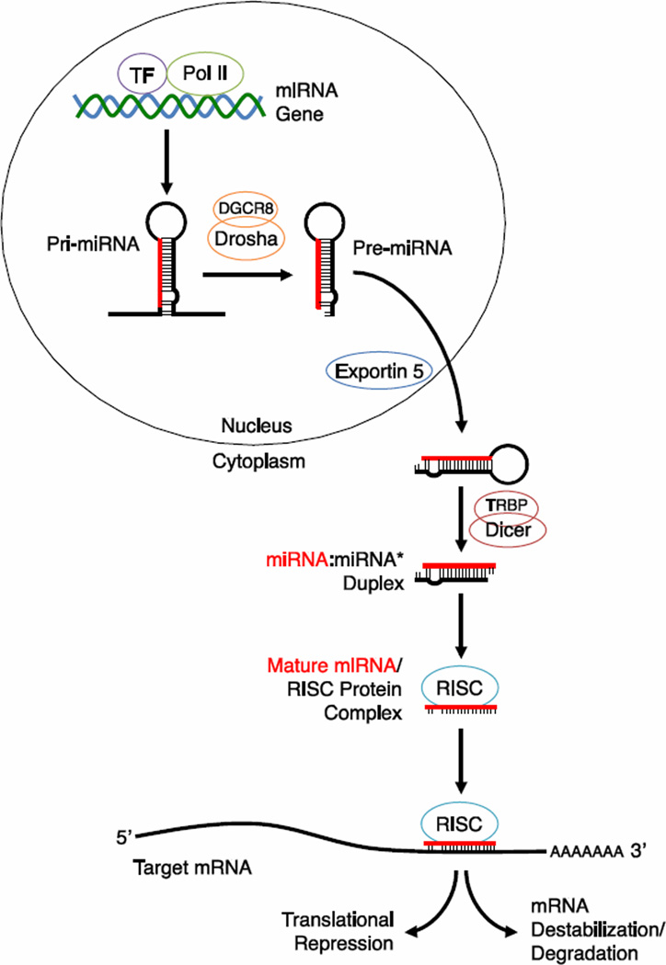
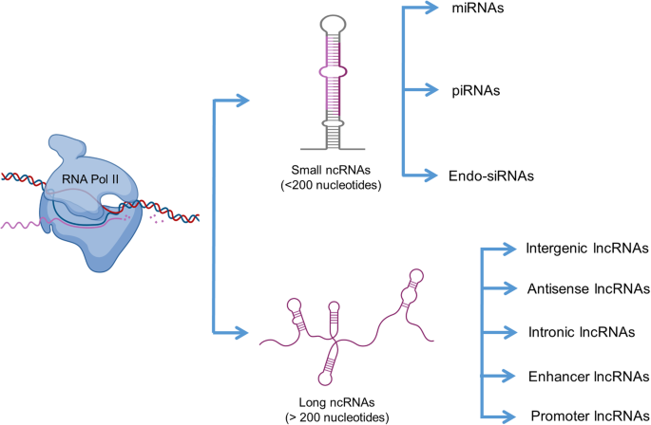
EPIGENETIC MARKS: NON-CODING RNAS
miRNA regulatory mechanism
Non-coding RNAs
Types of non-coding RNAs
Joshi et al. Repr Biol Endocr 2020
Gurtam et al. Journal of Molecular Biology 2013

Slide 10
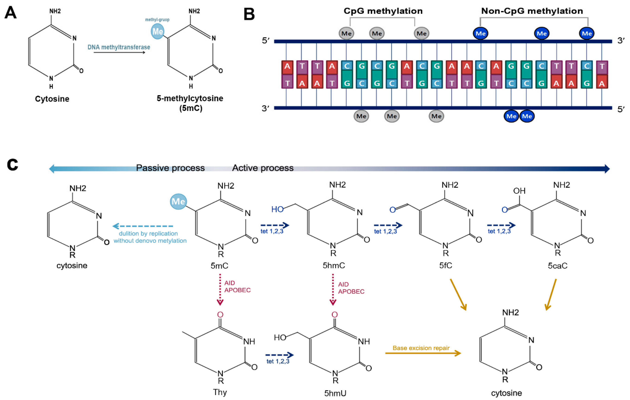
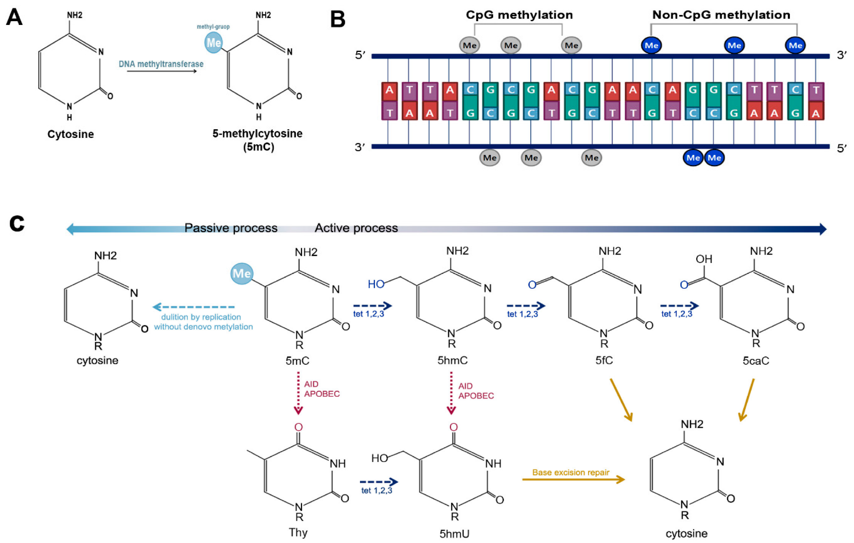
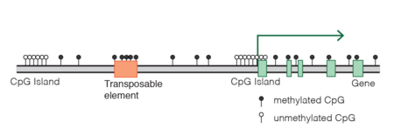
EPIGENETIC MARKS: DNA METHYLATION
DNA methylation

Slide 11
FUNCTIONS OF THE EPIGENOME
The epigenome regulates how genes are expressed (when, where, at what level…), thus it regulates:
Embryo and fetal development
Cellular differentiation
Chromosome X inactivation
Chromosome stability (ie. inhibition of DNA mobile elements)
Response to environmental factors
Involved in disease mechanisms

Slide 12
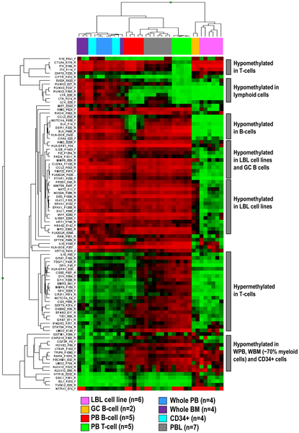
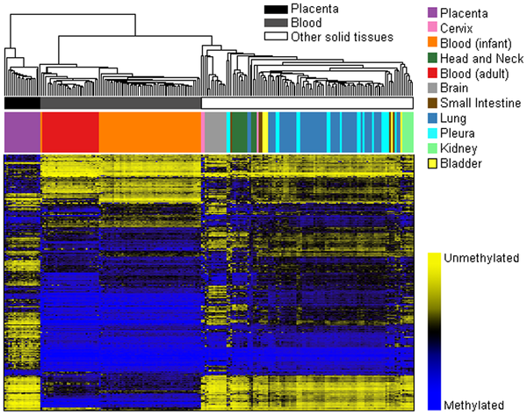
TISSUE AND CELL SPECIFICITY
Tissue and cell specificity

Slide 13
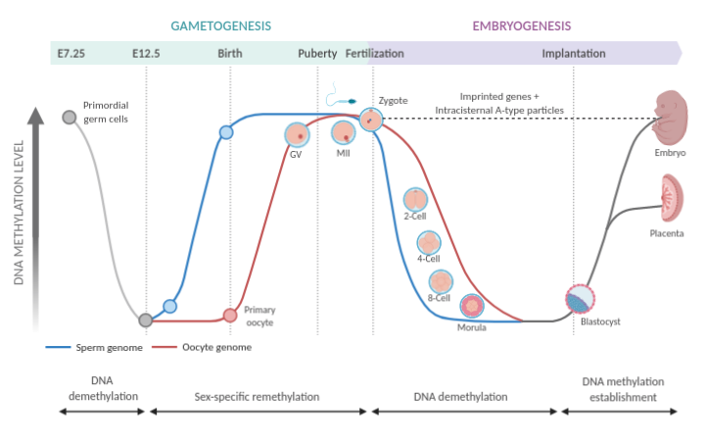
TIME SPECIFICITY
Fetal development
https://app.biorender.com/biorender-templates/figures/5c8c7ba9d4f2ef3300632942

Slide 14
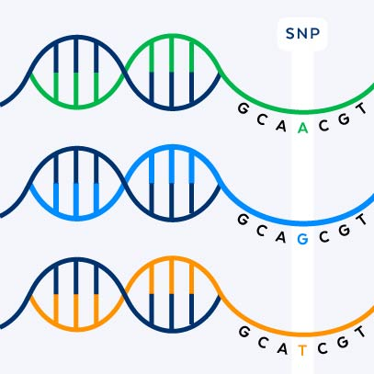
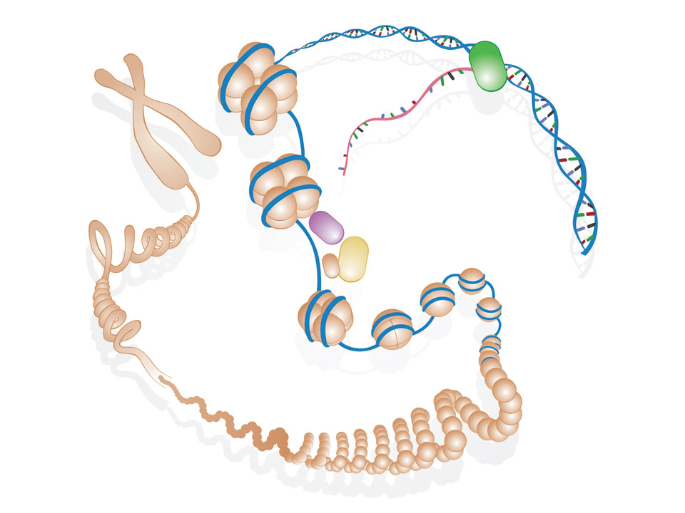
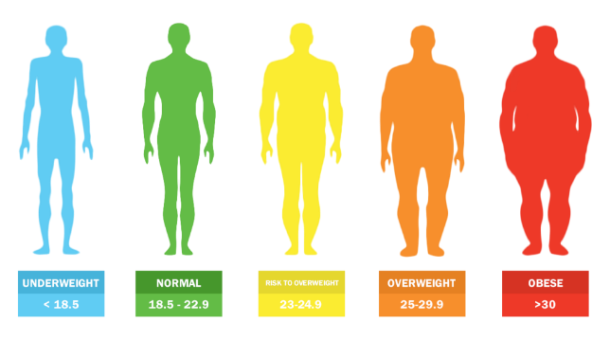
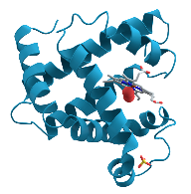
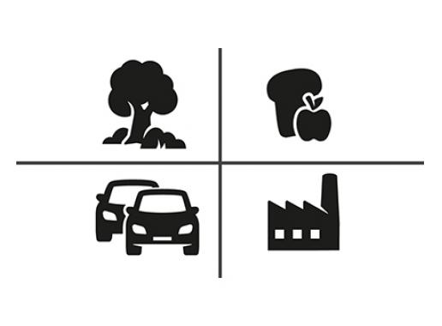
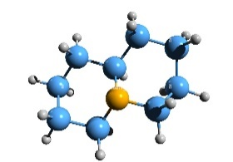
THE LINK BETWEEN EXPOSURES, GENETIC VARIATION AND TRAITS
Genetic variation
Epigenome
Transcriptome
Phenotype
GxE
Proteome
Metabolome
Environmental factors

Slide 15
APLICATIONS OF EPIGENETICS
Main applications of epigenetics
Understand biological mechanisms from environment to disease
Stratify disease in subtypes for diagnosis
Predict disease risk, treatment response…
Predict past exposures

Slide 16
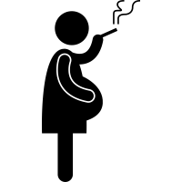
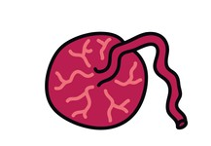

UNDERSTAND BIOLOGICAL MECHANISMS
Maternal tobacco smoking – placental methylation – birth weight
CpGs
growth-factor signaling
hormone activity
inflammation
vascularization
CpGs
overlap with
genetic variants of birth weight
Everson et al. Nat Comm 2021

Slide 17
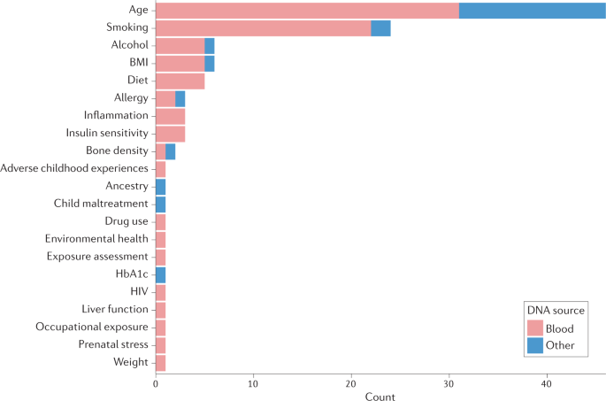
EPIGENETIC SCORES FOR PREDICTION
Prediction of health risk factors and exposures
Yousefi et al Nat Rev Genet 2022

Slide 18
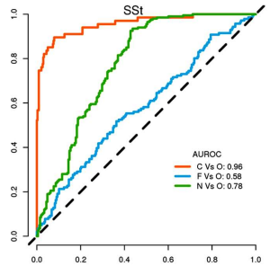
EPIGENETIC SCORES FOR PREDICTION
Prediction of health risk factors and exposures
Prediction of smoking status
EpiSmokEr R package – blood methylation data
C: Current, F: Former, N: Never and O: other two categories
Yousefi et al Nat Rev Genet 2022
Bollepalli, bioarxiv 2022

Slide 19
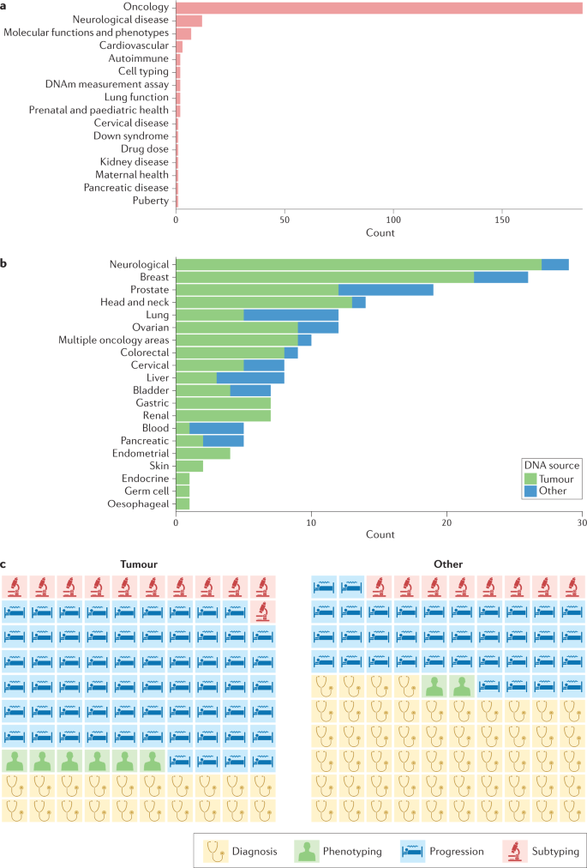
EPIGENETIC SCORES FOR PREDICTION
Prediction of health outcomes
Yousefi et al Nat Rev Genet 2022

Slide 20
EPIGENETIC SCORES FOR PREDICTION
Prediction of health outcomes
Oncology
Yousefi et al Nat Rev Genet 2022

Slide 21
EPIGENETIC SCORES FOR PREDICTION
Prediction of health outcomes
Oncology
Yousefi et al Nat Rev Genet 2022

Slide 22
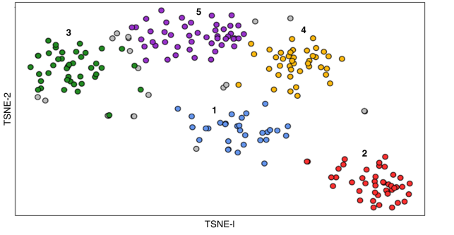
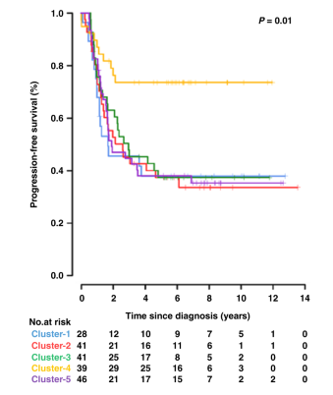
EPIGENETIC SCORES FOR PREDICTION
Primary neuroblastoma
Prediction of health outcomes
Oncology
Yousefi et al Nat Rev Genet 2022
H. Lalchungnunga British Journal of Cancer 2022

Slide 23
INTRODUCTION TO EPIGENOME-WIDE ASSOCIATION STUDIES (EWAS)
EPIGENETICS AMONG TRANSITIONING
AFRICAN POPULATIONS
(Felix P Chilunga)

Slide 24
INTRODUCTION TO EPIGENOME-WIDE ASSOCIATION STUDIES (EWAS)
RESOURCES AND TOOLS FOR EPIGENETICS

Slide 25
INSTALL R AND R PACKAGES
Install R environment version xxxxxxxxxxxx
Install R packages (GitHub: xxxxxxxxxxxxxxxx)
meffil
minfi? ExpressionSet?
Limma? ExpressionSet?
ggplot2?
ClusterProfiler¿???
….

Slide 26
GENE EXPRESSION OMNIBUS (GEO)
GEO = XXXXXXXXXXXXX
GEO XXX
Study on xxxxxxxxxxxxxxxx
Subset of controls
Aim: EWAS of own tobacco smoking

Slide 27
EXPRESSION.SET
ExpressionSet

